Slide 1

SMART UNIVERSITY MANAGEMENT SYSTEM
Where Technology Meets Education
BlackCode

Slide 2

INTRODUCTION
The Smart University Management System (SUMS) aims to streamline and automate the administrative, academic, and operational processes of a university. It provides an integrated platform for students, faculty, and administrators to manage tasks like course enrollment, attendance, marks management, scheduling, and leave requests efficiently.

Slide 3

PROBLEMS
Universities often rely on multiple, disconnected systems to handle student records, faculty data, attendance, and exam schedules.
Recording attendance, managing marks, and scheduling exams manually are prone to human error, affecting the reliability of records.
Students and faculty often lack real-time access to critical information, such as attendance records, exam schedules, or course statuses.

Slide 4
SOLUTION
Real-time operations like attendance marking, marks updates, or course enrollment reflected in the database immediately
Centralization of all university management tasks into a single platform, integrating student records, faculty data, attendance, and exam schedules.
Automating attendance recording, marking management, and exam scheduling thus reducing the potential for human error.

Slide 5
3 TIER ARCHITECTURE
PRESENTATION TIER
Technology: JavaFX
Desktop application UI
APPLICATION TIER
Technology: Java, Controllers, Services
Handling user Request & Business logic
DATA TIER
Technology: MySQL Database
Data storage and retrieval

Slide 6
GRASP | GOF PATTERNS
Controller: Separate UI controllers for Admin/Faculty/Student
Low Coupling: Modular package structure
High Cohesion: Each class has single responsibility.
Singleton: SessionManager for user sessions
Factory: Creation of entities (Users, Courses)
Observer: UI updates on data changes

Slide 7
Use Cases Implemented
User Authentication
Student Profile Management
Student Registration
Course Enrollment
Class Schedule Management
Exam Schedule Management
Leave Management
Attendance Management
Marks Management

Slide 8
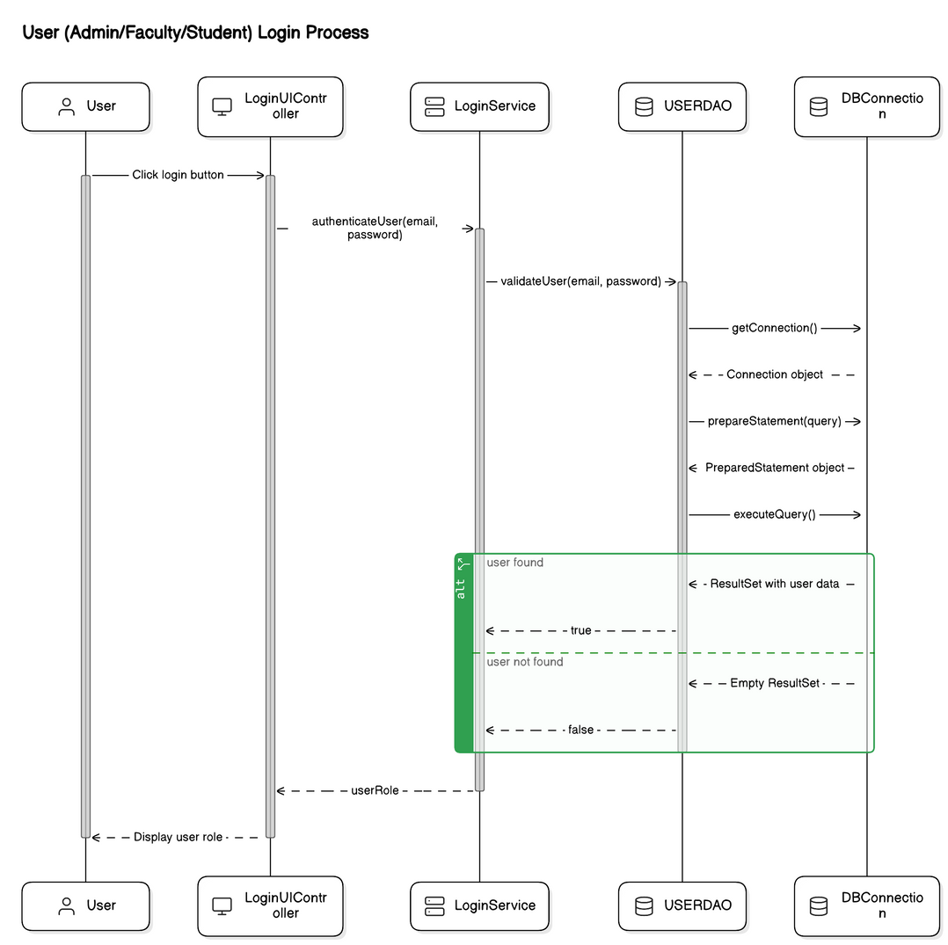
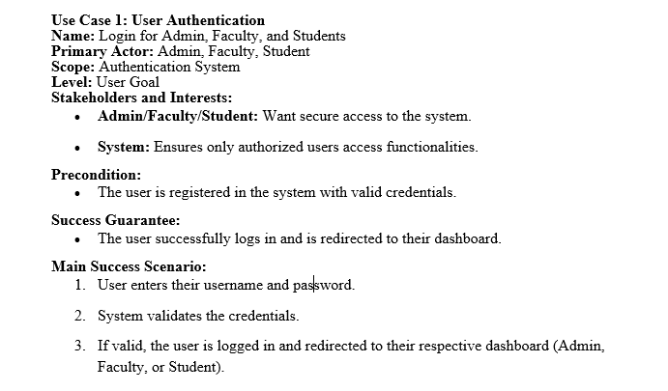
KEY USE CASE (LOGIN)

Slide 9
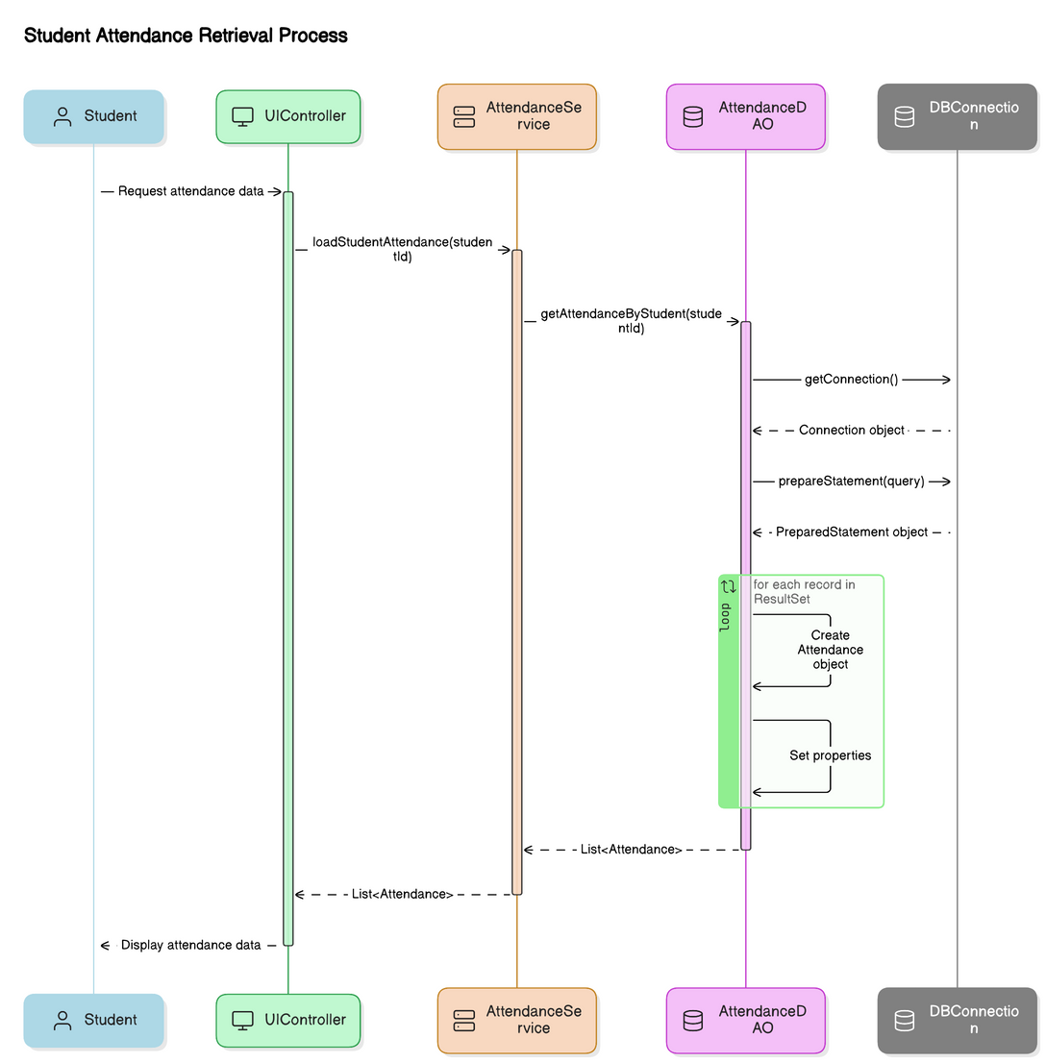
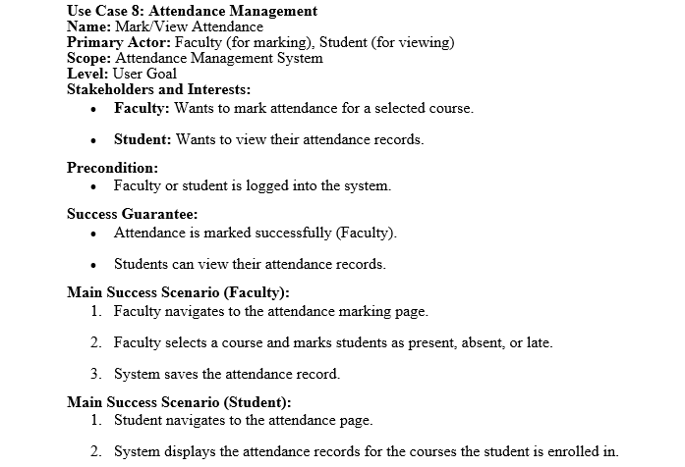
KEY USE CASE (ATTENDANCE)
FOR STUDENT VIEW

Slide 10
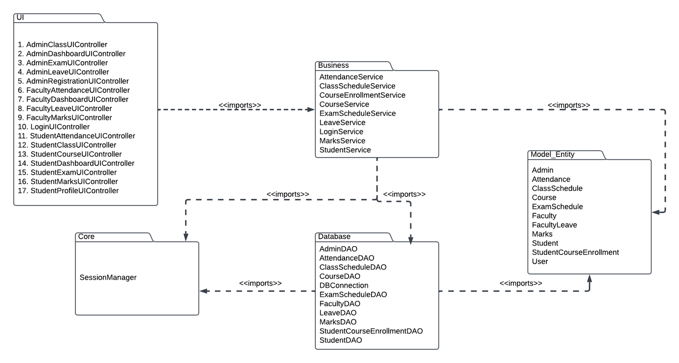
PACKAGE DIAGRAM

Slide 11
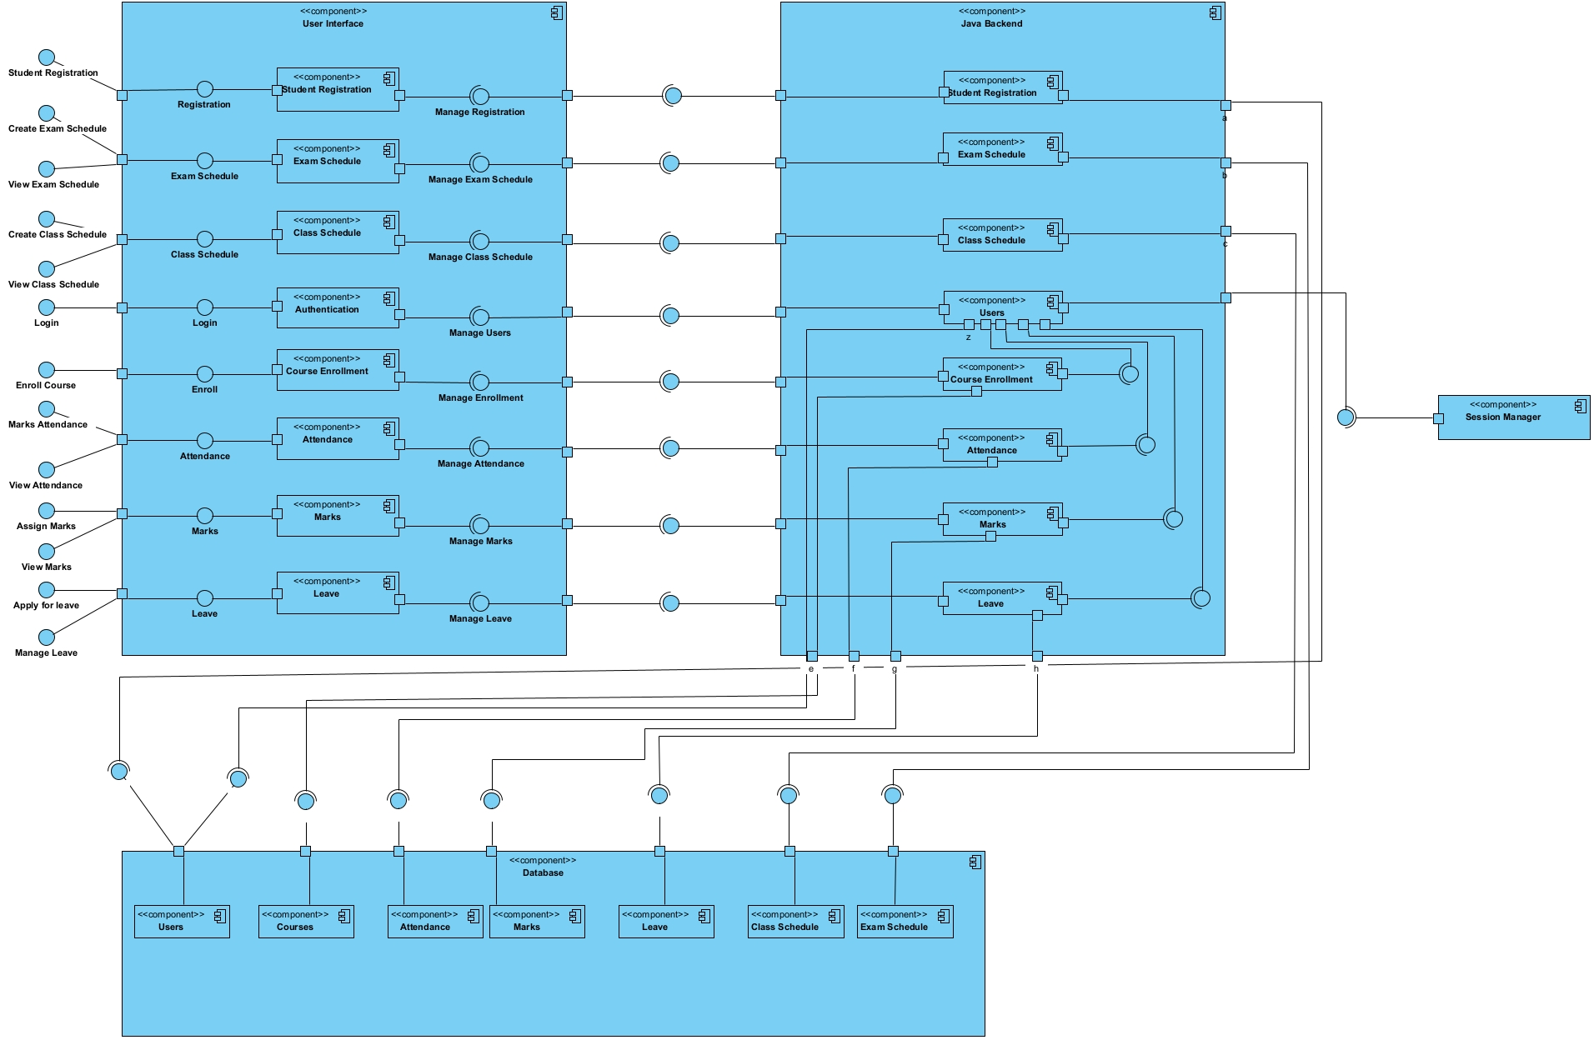
COMPONENT DIAGRAM

Slide 12
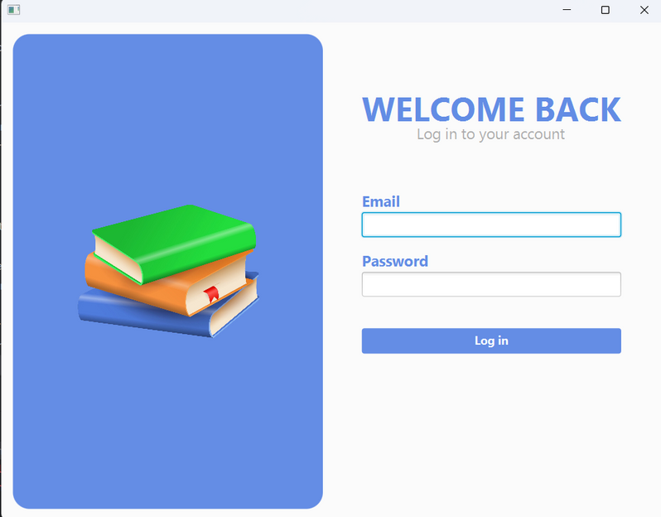
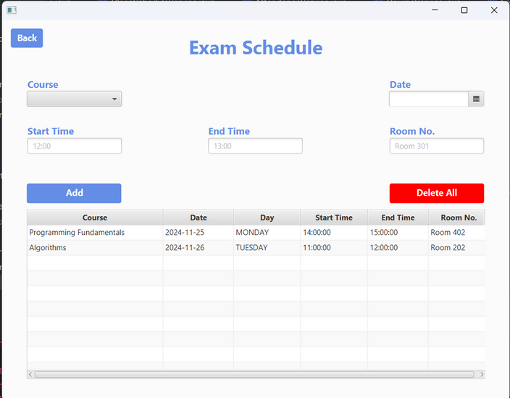
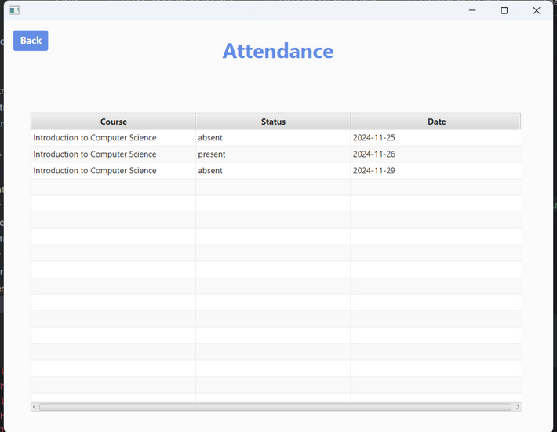
USER INTERFACE

Slide 13
THANK YOU

